Slide 1

Re-charter training
2021-2022
100% ACCURATE & On-TIME
Heart of America Council

Slide 2
Additional Recharter Training
https://www.hoac-bsa.org/internet-rechartering
  2020-2021 Recharter Training (Powerpoint)
https://www.scouting.org/commissioners/internet-rechartering/
  You can print your charter certificate and membership cards here!

Slide 3
Charter Renewal - Phases 1 & 2
Phase 1 - Be Prepared (July – August)
  Activities and Planning accomplished BEFORE Internet Rechartering
Phase 2 - Do Your Best (August – October)
  Enter Data during Internet Rechartering
  Collect Fees
  District Review and Resolve Defective Recharter Packets

Slide 4
Charter Renewal - Phases 3 & 4
Phase 3 - Do Your Duty (October – December)
  Council Review and Posting of Charters
Phase 4 - Raise the Colors (December – February)
  Unit Leader Print Cards
  Charter Presentations

Slide 5
Availability and Due Date
Log On – August 1, 2021
  Log on for Internet Recharter 3-months (August 1) prior to
  renewal date, October 30, 2021
  ALL units… ALL recharter documentation
  LATE Charters…
  NO Grace Period, NO Insurance, NO Advancement
District Recharter Turn-in Dates
  Ask your Unit Commissioner or District Professional
  Several Opportunities Sept - Mid October

Slide 6
Just Like Last Year…
Recharter cycle will coincide with the Scouting program year
ALL Adults must complete Youth Protection Training
ALL NEW Adults must have Background Authorizations
ALL Direct Contact Leaders must be fully trained
Council Program Fee - $39
Free Rank Advancement for all Scouts
Registration Fee Assistance (up to 50% off)
  *Contact your District Professional for assistance opportunities and application information.

Slide 7
Just Like Last Year…
August - November

Slide 8

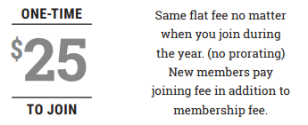
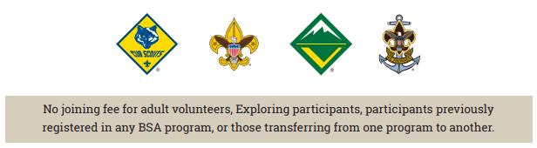
Only for New Scouts

Slide 9
Just Like Last Year…

Slide 10
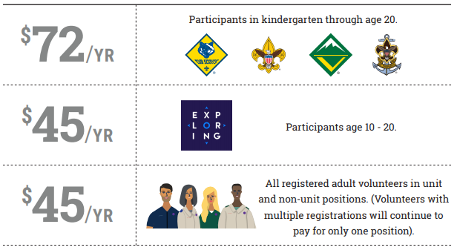
New This Year…

Slide 11
New This Year…
Total Cost:
  Youth: $111
  Adult: $84
No option to pay Recharter Fee with credit card through Internet Recharter

Slide 12
Be Prepared… Do This First
Identify Key Personnel
  Identify & Train Unit Recharter Renewal Processor
  Contact your Unit Commissioner
  Know your District Professional
Review Internet Rechartering Tutorial; https://www.scouting.org/commissioners/internet-rechartering/

Slide 13
Be Prepared
Roster and Training Manager (feature in My.Scouting)
    Tutorials for My Dashboard, Training Manager, Organization Manager, and more​
    Roster
      Inventory all members and adult positions
      Print youth & adult roster and membership cards​
    Training Manager
      Review & update leader training records including YPT and Job Specific
      Take Youth Protection Training and Job Specific Training

Slide 14
Be Prepared
Complete membership inventory of all youth & adults. Identify dropped members, continuing members, and new members.
Determine changes to key unit leadership. Identify replacements and/or additions.
Determine leadership positions for ALL adults.
Collect Applications for all NEW youth & adult members that haven’t been turned in through Recruitment Efforts.

Slide 15
Be Prepared
Collect Background Disclosures for all NEW adult members (last page of application).
*Background Disclosure Forms
  Criminal background check only. No consumer/credit check.
  Signature form must be included with application or received prior at Council Service Center.
  Adults WILL NOT be registered without the signed form.

Slide 16
Be Prepared
Confirm ALL Adults have current Youth Protection Training (YPT).
Confirm ALL Direct Contact Leaders are FULLY trained for their registered position. Fully trained includes all three levels (Before the 1st Meeting, First 30 Days, and Position Trained).
Collect training verification for ALL new Direct Contact Leaders.

Slide 17
Direct Contact Leaders that Require Position Specific Training
  CM – Cubmasters
  SM – Scoutmasters
  NL – Venture Crew Advisors
  SK – Sea Scout Skipper
  ALL Den Leaders (LL, TL, DL, WL)

Slide 18
Do Your Best… The Process
Unit receives Access Code via email to Unit Key 3
Go to the Council website and select Internet Rechartering
https://www.hoac-bsa.org/internet-rechartering
Immediately Log into Internet Recharter from council site above and review roster
Collect the current fee for every registered youth & adult except for new scouts (See 2021-2022 Fees)
  Collect Cash/Checks, or
  Collect SCOUTPAY Receipts

Slide 19
Do Your Best
Electronic Authorization
  Available for the COR
  No signatures required if this option is chosen
Print recharter paperwork
If needed, Obtain signatures of Unit Leader & Executive Officer on applications/charter paperwork
Turn-in charter paperwork
    (member applications not turned in at Sign Up Night, SCOUTPAY receipts, background authorizations, training verifications)
Pay Recharter Fee with check or unit account.

Slide 20
2021-2022 Fees
  12 Months (November 1, 2021 – October 31, 2022)
    Unit Liability Insurance Fee--$75 (unit charter fee)
    Scout Life Magazine--$12 (Optional)
  NO Fee for Lion/Tiger Cub Adult Partners
  NO Fee for ‘Multiple’ Position Registrations
 | National Fee | Council Fee | New-Member Fee | Total Fee (12-months)
Scout - New | $72 | $39 | $25 | $136
Scout - Returning | $72 | $39 | - | $111
Explorer New or Return | $45 | - | - | $45
Adult - ALL | $45 | $39 | - | $84

Slide 21
2 Ways for Families to Pay
1) Traditional Recharter:
  Unit collects and manages all fees
  2) Families pay individually through
  Features:
  Easy Payment System
  Monthly Options (1x / 2x / 3x / 4x)
  Recurring Payments (Aug. – Nov.)

Slide 22
Required Unit Membership
Executive Officer / Institutional Head (IH) can be any position in the unit (but must pay the registration fee for an additional position)
Chartered Organization Representative (COR) can also be the Committee Chair (CC) or a Committee Member (MC)
All other leader positions…one person - one job

Slide 23

Required Unit Membership
Cub Scouts
  Institutional Head (IH) - No Application or Fee
  Charter Organization Representative (CR)
  Committee Chair (CC)
  Cubmaster (CM)
  At Least Two (2) Committee Members (MC)
      or 1-MC and 1-Pack Trainer (PT) or 1-New Member Coord (NM)
  At Least One (1) Den Leader (LL, TL, DL, WL)
  At Least Five (5) Youth Members
  Must Have One (1) Lion/Tiger Adult Partner for every Lion/Tiger Cub – No Fee for partner positions

Slide 24
Required Unit Membership
Cub Scouts
Lion/Tiger Adult Partners
No fee or application required
They may register in another leader position with fee, application, background, YPT.
If the Adult Partner’s physical address is different from the Youth.
  Adult Application is Required
  Youth Protection Training is Required
  No Fee is charged

Slide 25
IMPORTANT !!!
Webelos Crossing Over
Encourage that Webelos re-register with the Pack and then transfer to the Troop when the Arrow of Light (AOL) paperwork has been turned in to the Council.
Make sure any Webelos crossing over have their Arrow of Light paperwork turned in at the Council BEFORE registering with a Troop.
If they register with a troop prior to turning in the AOL paperwork to the Council, they CANNOT earn the AOL - this is a mistake that cannot be undone!

Slide 26



Required Unit Membership
Troops, Crews, & Sea Scouts
  Institutional Head (IH) - No Application or Fee
  Charter Organization Representative (CR)
  Committee Chair (CC)
  Scoutmaster (SM), Crew Advisor (NL) or Sea Scout Skipper (SK)
  At Least Two (2) Committee Members (MC)
      or 1-MC and 1-New Member Coord (NM)
  Minimum of Five (5) Youth Members

Slide 27
IMPORTANT !!!
Scouts / Sea Scouts & Venturers Age 18-20
Considered a youth for program purposes
  HOWEVER
All Sea Scouts and Venturers age 18-20 must complete:
  Adult Application
  Youth Protection Training
  Undergo a Background Check and Include Disclosure Form
  Position Code
    Crew - Venturing Participant (VP)

Slide 28
Information Input
(online recharter will allow…but when synced with other systems, things get screwed up)
No spaces in last names (DeCarlo not De Carlo)
No apostrophes (OBrien not O’Brien)
No initials for first names
Use an initial for a middle name, no period after initial.
Prefixes are Dr., Rev.
Suffixes are Jr., III, etc.
No need to enter Mr. or Mrs.

Slide 29

Information Input
Change wrong contact information (Address, phone number, etc.)
Change grades if wrong, BUT don’t “update” to the next year’s grade.
This happens automatically by BSA

Slide 30
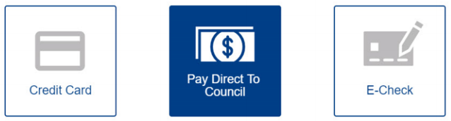
Internet Rechartering
Electronic Options
Electronic Authorization
  Available for the COR
  No signatures required if this option is chosen
Electronic Internet Recharter Payment

Slide 31
Internet Rechartering
Use this year’s access code
Log in as First-Time User
www.hoac-bsa.org
  Under “RESOURCES” tab
  Select “Internet Rechartering”
Supported browsers
  Firefox, Chrome (Best), IE 10 & 11, Edge
  MAC Computers not supported

Slide 32
Internet Rechartering
Update roster
  Update information
  Renew Current Members
  Add adult members
  Add youth members
  Update member data
  Update positions
  Ensure non-members are removed at re-charter

Slide 33
Internet Rechartering
Update member fees
  Assign “Multiple” status (youth and adults)
  Sign up members for Scouts’ Life Magazine
Survey: Why Scouts are not re-chartering
After double checking everything, click SUBMIT sends information to council
PRINT paperwork and turn-in hardcopy and payment to council/district

Slide 34
Internet Rechatering
Obtain signatures
  Paper (wet signatures)
    Charter Organization’s Executive Officer (IH), and
    Unit Leader
  OR – only COR can elect to use electronic authorization
Note: “Submit to Council” on Internet = NOT COMPLETED
Paperwork
  Printed Recharter, New Applications, Adult Background Authorization Forms, Fees, SCOUTPAY Receipts
  Take to your District Recharter Meeting
  OR – take to the Council Service Center
Fees - Pay directly with check or unit account.
  Paid at your District Recharter Meeting
  OR – at the Council Service Center

Slide 35
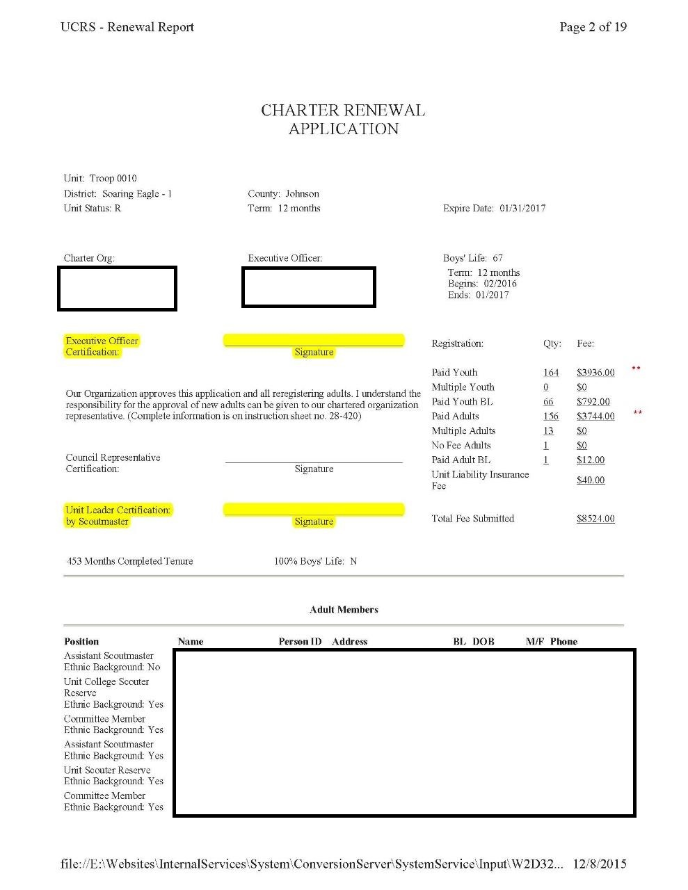
Charter Renewal Application
If the Executive Officer has changed, cross this out and write in correct information
Requires Signatures from unless COR signs electronically:
  Executive Officer (IH)
  Unit Leader
    Cubmaster
    Scoutmaster
    Crew Advisor
  NOT Committee Chair or Renewal Processor

Slide 36
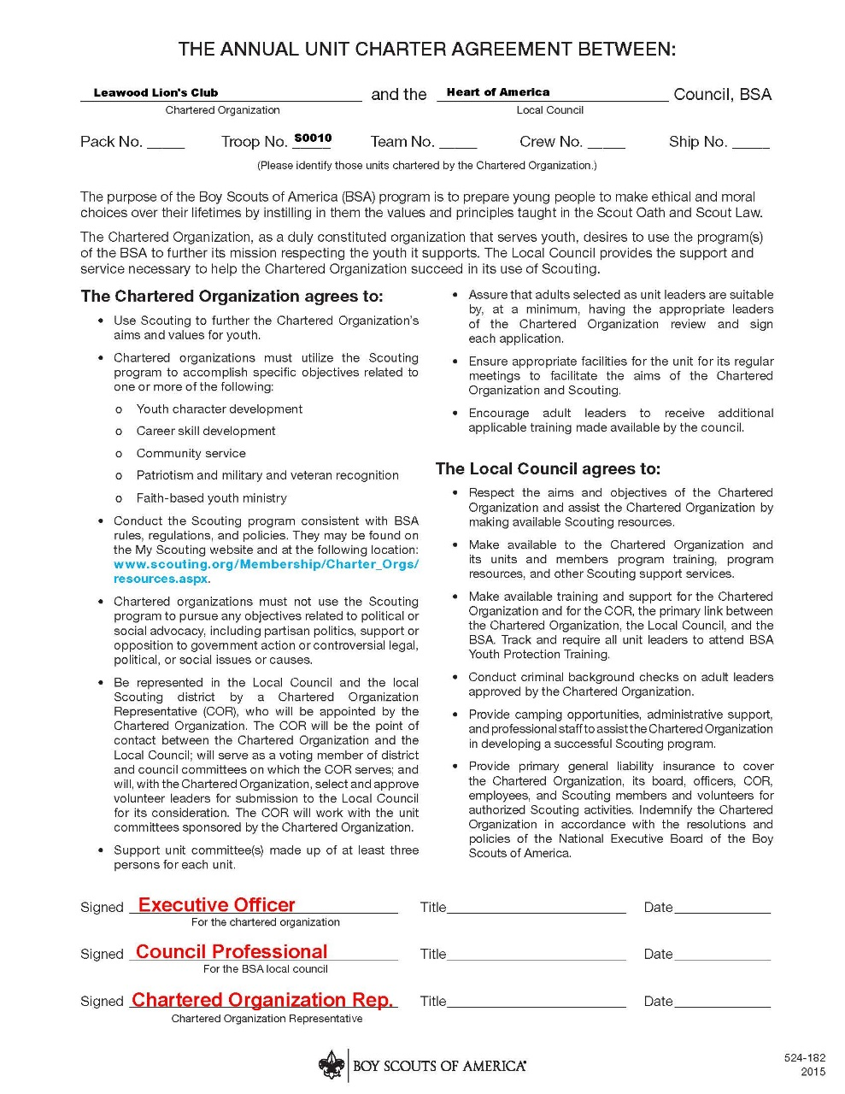
Annual Charter Agreement
Requires Signatures from:
  Executive Officer (IH)
  Charter Organization Rep. (COR)
  This is a necessary conversation

Slide 37

Questions?

