Slide 1


Re-charter Training
2019
Boy Scouts of America
Heart of America Council

Slide 2

What is a “Charter”
An Agreement
BSA: Agrees to provide Program. Permission to an organization to use Scouting program as part of its youth service program.
Chartered Organization: Agrees to provide support.
Renewed annually.

Slide 3
Why Re-charter ?
Annual renewal of partnership – BSA and Chartered Organization.
Updates paperwork of who is active and who is not.
No one volunteers for more than one year. Scouting is NOT a lifelong commitment. You renew that commitment annually.
Liability & accident insurance coverage to the Chartered Organizations and registered participants.

Slide 4
NEW THIS YEAR !!!
ALL ADULTS must have completed the New Youth Protection training (since February 2018) before they can be registered or re-registered.
ALL Direct Contact Leaders must be fully trained for the position in which they serve in order to re-register.
Fully Trained includes completing all three levels of training (Before the 1st Meeting, First 30 Days, and Position Trained).

Slide 5
NEW THIS YEAR !!!
Direct Contact Leaders
  CM – Cubmasters
  SM – Scoutmasters
  NL - Venture Crew Advisors
  SK – Sea Scout Skippers)
  ALL Den Leaders (LL, TL, DL, WL)
  Leaders of 11-year-old Scouts LDS
  Paid or Multiple registered

Slide 6
NEW THIS YEAR !!!
UNIT SCOUTER RESERVE POSITIONS
  The use of registration code 91U (Unit Scouter Reserve) will no longer be accepted.
  The use of code 92U (College Scouter Reserve) will only be allowed for leaders 18-20 years old who will not become Assistant Scoutmasters.

Slide 7
NEW THIS YEAR !!!
UNIT SCOUTER RESERVE POSITIONS
  Adults that hold the 91U position will be re-registered as a Committee Member by default.
  They may also elect to re-register as an Assistant Scoutmaster, or other Assistant Direct Contact position.

Slide 8
NEW THIS YEAR !!!
All HOAC leaders are encouraged to complete their position specific training in order to better understand how the Scouting program works and to give excellent support to unit leaders, Scouts, and parents.

Slide 9
DO THIS FIRST
Identify the Key Personnel
  District Professional
  District Commissioner
    District Recharter Trainer
  Unit Commissioner
    Unit Recharter Facilitator

Slide 10
Pre-Planning Steps
    Consider key unit leadership personnel to determine replacements, additions & changes.
    Complete membership inventory of all youth & adults. Identify dropped members, continuing members and new members.
    Determine leadership positions for ALL adults.
    Collect applications for all NEW youth & adult members.
    Collect training verification required for ALL new adults & adults that are changing positions.

Slide 11
Pre-Planning Steps
    Confirm ALL Adults have completed the NEW Youth Protection Training.
    Confirm ALL Direct Contact Leaders are FULLY Trained for their position.
    Make sure the membership personal information is accurate, address, phone, e-mail, etc.

Slide 12
Process
Unit receives access code with Recharter Packet
Unit receives location & date of Recharter Turn in Day
Go to the council Web site and select Internet Rechartering
Complete the rechartering process
Print recharter paperwork
Obtain signature of Unit Leader & Executive Officer
Turn-in charter paperwork, member applications, training verifications,
correct fees or unit account authorization.

Slide 13

Fees
$33 for every registered youth & adult
  NO Fee for Lion/Tiger Cub Adult Partners
  NO Fee for ‘Multiple’ Position Registrations
$12 for Boy’s Life Magazine
$40 Charter fee for each UNIT.

Slide 14
Units Require Specific Members
Cub Scouts
  Institutional Head (IH) – No Application or Fee
  Charter Organization Representative (CR)
  Committee Chair (CC)
      IH – CR – CC can be the same person
  Cubmaster (CM)
  2 Committee Members (MC)
      or 1 Committee Member & 1 Pack Trainer
  At Least One Den Leader
  Must Have 1 Lion/Tiger Cub Adult Partner
  for every Lion/Tiger Cub
  Must Have at least Five (5) Youth Members

Slide 15
Units Require Specific Members
Cub Scouts
  Lion / Tiger Cub Adult Partners
    No fee or application required
    They may register in another position
    with fee & application
  Optional Positions
    Assistant Cubmaster (CA)
    Assistant Den Leaders (Lion,Tiger,Den,Webelo)
    Pack Trainer (PT)
    Unit College Reserve age 18-20; (92U)
    New Member Coordinator (NM)

Slide 16
Units Require Specific Members
Cub Scouts
  Lion / Tiger Cub Adult Partners
  If the Adult Partner’s physical address is different from the Youth.
  Adult Application is Required
  Youth Protection Training is Required
  No Fee is charged

Slide 17
IMPORTANT !!!
Cub Scouts
Make sure any Webelos crossing over have their Arrow of Light paperwork turned in at the Council BEFORE registering with a Troop.
If they register with a troop prior to turning in the AOL paperwork to the Council, they CANNOT earn the AOL - this is a mistake that cannot be undone!
They can register with the Pack and then transfer to the Troop when the AOL paperwork has been turned in to the Council.

Slide 18
Units Require Specific Members
Troops & Crews
  Institutional Head (IH) – No Application or Fee
  Charter Organization Representative (CR)
  Committee Chair (CC)
      IH – CR – CC can be the same person
  Scoutmaster (SM) or Crew Advisor (NL)
  2 Committee Members (MC)
  Must Have at least Five (5) Youth Members

Slide 19
Units Require Specific Members
Troops & Crews
  Optional Positions
    Assistant Scoutmaster (SA)
    Crew Associate Advisor (NA)
    Unit College Scouter Reserve – age 18-21; (92U)
    New Member Coordinator (NM)

Slide 20
IMPORTANT !!!
Venturers Aged 18-20
All Venturers aged 18-20 must complete an adult application and meet adult membership criteria, including taking Youth Protection Training (YPT) and undergo a background check.
  Position is “Venturing Participant”
    Position Code is: ‘VP’
  Considered a youth for program purposes
Notes:
****
NOTE TO PRESENTER:
AS A REPRESENTATIVE OF THE COUNCIL, PLEASE BE SURE THAT YOU CLEARLY INFORM CREWS AND SHIPS OF THE NEED TO CHECK THE RECHARTER WEBSITE FOR UPDATES TO THE PROCEDURE FOR RECHARTERING VENTURERS AGED 18-20. IT IS IMPORTANT THAT WE CONVEY THAT THE RULES COULD CHANGE FOR EXISTING MEMBERS AND ALREADY HAVE CHANGED FOR NEW MEMBERS. WE WILL GET ANY CHANGES POSTED AS SOON AS WE CAN GET THE ANSWERS.
****
BSA National modified membership rules for Venturers aged 18-20 effective March 1, 2015.
Effective that date, a new Venturer aged 18-20 must complete an adult application as a “Venturing Participant” (VP) and meet the requirements for adult membership. That means they must complete YPT course Y02 (Venturing YPT), pass a criminal background check, and answer the questions on the adult application. Once the council accepts the application, a Venturing Participant is considered a youth participant in the crew of ship until age 21 and able to participate in all youth activities and advancement programs.
Any new Venturers aged 18-20 added to a crew or ship during recharter are subject to the above requirements. The requirements also apply to any existing Venturer aged 18-20 who registers in a different crew or ship.
Due to conflicting statements issued by BSA National, it is not clear what impact the policy change has on rechartering youth who have continued as members of the same crew or ship since March 1, 2015. We believe that crews and ships should be prepared to meet the new requirements for all EXISTING youth members aged 18-20. This entails obtaining adult applications and YPT Y02 training credentials for all Venturers aged 18 and older.
Once the council receives clarification of how this policy change affects existing Venturers, an update will be posted on the recharter website to clarify the procedures that crews and ships must follow.

Slide 21
Common Re-Charter Mistakes

Slide 22
COMMON MISTAKES
MISSING or UNSIGNED or INCOMPLETE
Youth & Adult Applications for all NEW members
  Adults
    Disclosure Form not completed & signed
    3 references missing
    All questions not answered.
    2 certifying initials missing
    SSN missing
Required Leadership Positions not identified
  COR – CC – 2MC – CM/SM/NL – DL
Charter Paperwork not signed
  by COR, Executive Officer (IH) & Unit Leader

Slide 23

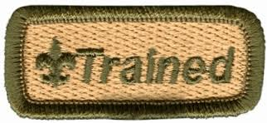
COMMON MISTAKES
DIRECT CONTACT LEADERS Not Fully Trained for their Position
ALL REGISTERED ADULTS Not current in the NEW Youth Protection Training

Slide 24
Too Many Multiple Positions in Same Unit
Chartered Organization Rep can also be the Committee Chair or Committee Member.
IH can be any position in the unit (but must pay the registration fee for that position).
All other positions – one person, one job.

Slide 25

People Multiple Out of the Program
Some Scouters “Multiple” everywhere.
Each person must have a primary position for which they pay the registration fee.
When the “primary registration” becomes due and not renewed, that person drops from being registered in any position.

Slide 26
Information Input
No spaces in last names (DeCarlo not De Carlo)
No apostrophes (OBrien not O’Brien)
No initials for first names
Use an initial for a middle name, no period after initial.
Prefixes are Dr. Rev.
Suffixes are Jr. III, etc.
No need to enter Mr. or Mrs.

Slide 27

Information Input
Change wrong contact information (Address, phone number, etc.)
Change grades if wrong, but don’t “update” to the next year’s grade.
This happens automatically by BSA

Slide 28
Internet Rechartering
Electronic Option
Electronic Authorization
  Available for the Charter Org Representative
    No signatures required if this option is chosen
Online Payment Option
  Units can elect to pay with using:
    credit card, electronic check
Notes:
****
NOTE TO PRESENTER: If you get a lot of questions about the current slide, defer the questions until the next slide is displayed.
The information on the current slide is virtually everything we know as of October 3, 2015.
****
These changes were emailed to the council registrar on October 1, 2015. The council has questions about the details, so it is
expected that you will too. An update will be posted on the recharter website as we learn more.
We have been able to confirm that Internet Rechartering no longer displays a warning message when a user logs in using
Firefox or Chrome on Windows or Macintosh. The initial page for Internet Rechartering has been updated to list these browsers.
Changes were made to allow crews and ships to register Venturers aged 18-20 and to allow units to register a committee member as Unit Chaplain or Unit Religious Emblems Coordinator.
THE BIG CHANGE THAT AFFECTS ALL UNITS IS THAT INTERNET RECHARTERING IS NOW ACCESSED FROM MY<dot>SCOUTING, UNDER LEGACY WEB TOOLS, INSTEAD OF THE OLD MYSCOUTING PAGE. The direct link on the recharter web page also works, going directly to Internet Rechartering. No change of location for the Exploring counterpart was announced; it should still be accessible at lfl.participation.org.

Slide 29
Process
Unit receives access code with Recharter Packet
Unit receives location & date of Recharter Turn in Day
Go to the council Web site and select Internet Rechartering
Complete the rechartering process
Print recharter paperwork
Obtain signature of Unit Leader & Executive Officer
Turn-in charter paperwork, member applications, training verifications,
correct fees or unit account authorization.

Slide 30
Internet Rechartering
UNIT RECHARTER FACILITATOR
Use this year’s access code for re-chartering provided to each unit to log into the system.
(Log in as First-Time User)
www.hoac.org
  Under the RESOURCES TAB
  Select “Internet Re-chartering”
Supported browsers:
Firefox, Chrome, IE 9, 10, 11, Edge
Not compatible with MAC Computers

Slide 31

Availability and Due Date
You can log on for internet re-chartering 3-months prior to your renewal date:
  October 1, 2018
      Charters expiring December 31, 2018
  November 1, 2018
      Charters expiring January 31, 2019
Charter Turn-in Dates
  Ask your Unit Commissioner or Unit Professional
Charters submitted late
  NO GRACE PERIOD
  = No insurance, no advancement !!!

Slide 32
Internet Re-chartering
Update roster
  Update information
  Renew Current Members
  Add adult members
  Add youth members
  Update member data
  Update positions
  Ensure non-members are removed at re-charter
Load Council information from ScoutNet
  OR
  Upload file from PackMaster
  TroopMaster
  Scoutbook

Slide 33
Internet Re-chartering
Update member fees
  Assign “Multiple” status
  Sign up members for Boys’ Life
Survey: Why Scouts are not re-chartering
After double checking everything, SUBMIT information to council and print paperwork for signatures

Slide 34
Internet Rechartering
Obtain signatures from Charter Organization’s Executive Officer & Unit Leader
Note: “Submit to Council” on Internet = NOT COMPLETED
Must PRINT and SIGN all paperwork
Paperwork and fees
taken to the Council Office or to the Recharter Meeting for processing
  OR – elect to use electronic authorization
        (still need to submit New Youth & Adult Applications)
Fees must be paid at the council office or at
Recharter Meeting
  OR – elect online payment option
IF RECHARTER & PAYMENT IS DONE COMPLETELY ONLINE
& NO NEW APPLICATIONS ARE REQUIRED
Please notify your Unit Commissioner AND District Professional that you have submitted electronically

Slide 35
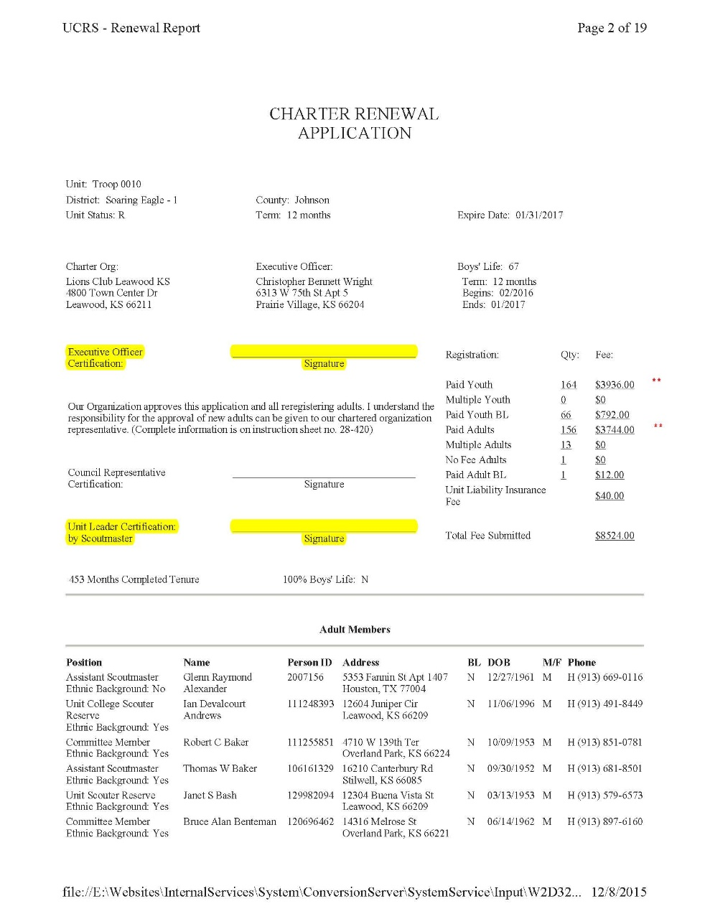
Charter Renewal Application
If the Exexcutive Office has changed, cross this out and write in correct information
Requires Signatures from:
  Executive Officer (IH)
  Unit Leader
    Cubmaster
    Scoutmaster
    Crew Advisor

Slide 36
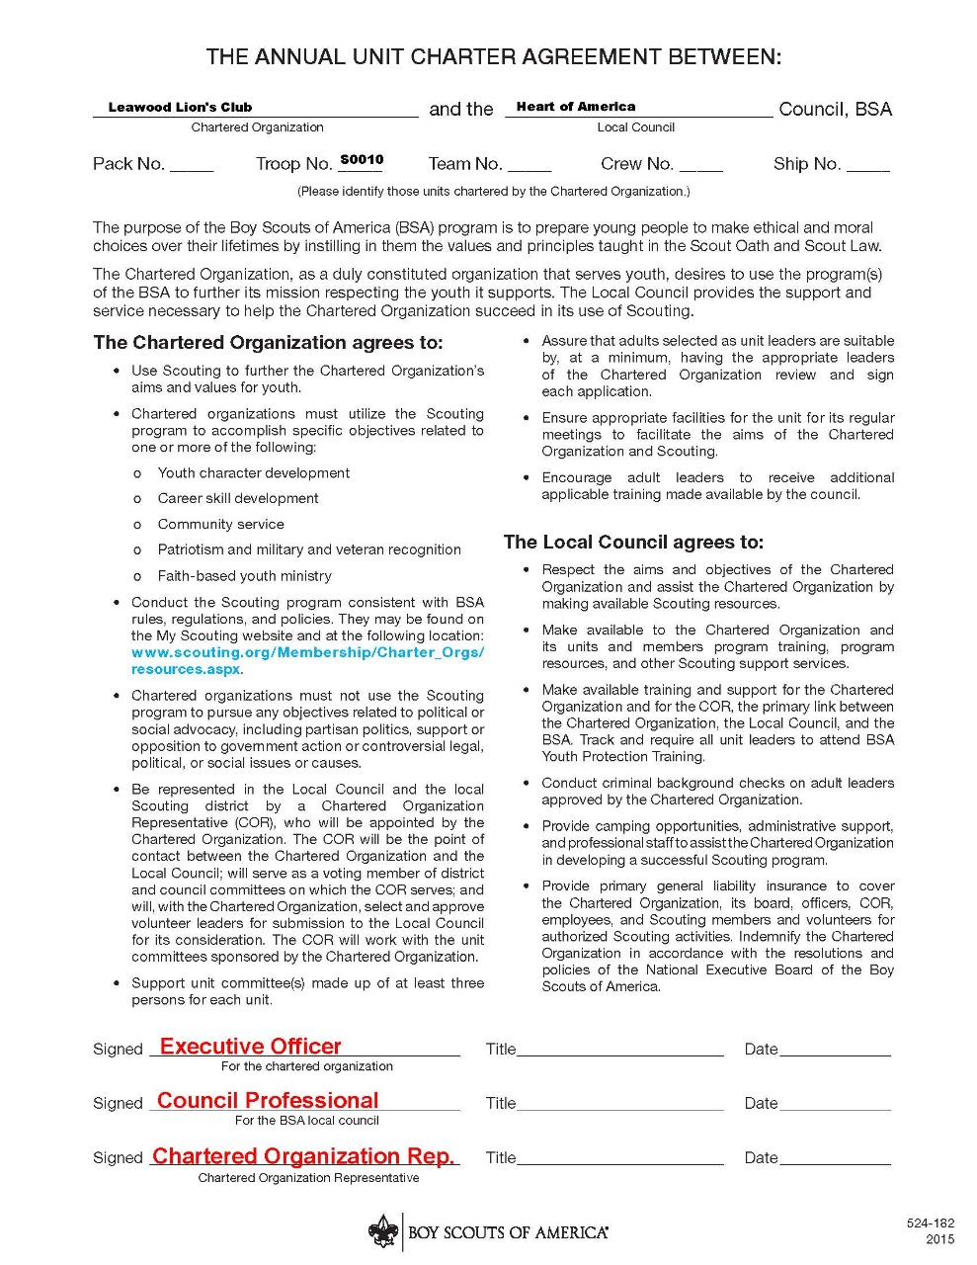
Annual Charter Agreement
Requires Signatures from:
  Executive Officer (IH)
  Charter Organization Rep. (COR)

Slide 37

Journey to Excellence
Complete Journey to Excellence form = qualified for Bronze, Silver, or Gold ?
Log your Service Hours for Good Turn for America (Link on JTE site at www.Scouting.org )

Slide 38
my.scouting.org Tools
Unit Key 3 (Unit Leader, CC, COR)
plus 3 designated registered Adults
Membership Management
  Print Youth & Adult Rosters
  Print Membership Cards
  Check & update contact information
Training Management
  Review, update & input Adult training records
  Review Youth Protection Training expiration dates

Slide 39



Internet Rechartering

Slide 40
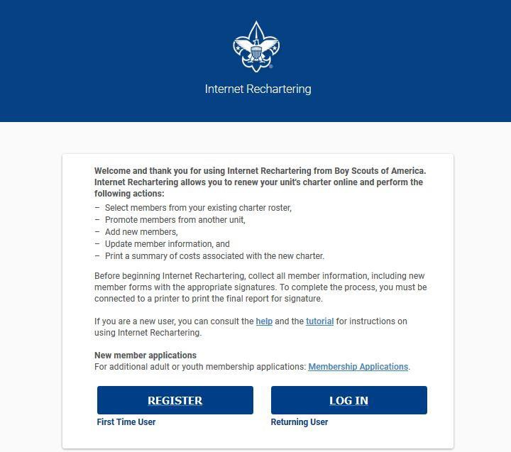
Access codes still distributed by Council

Slide 41
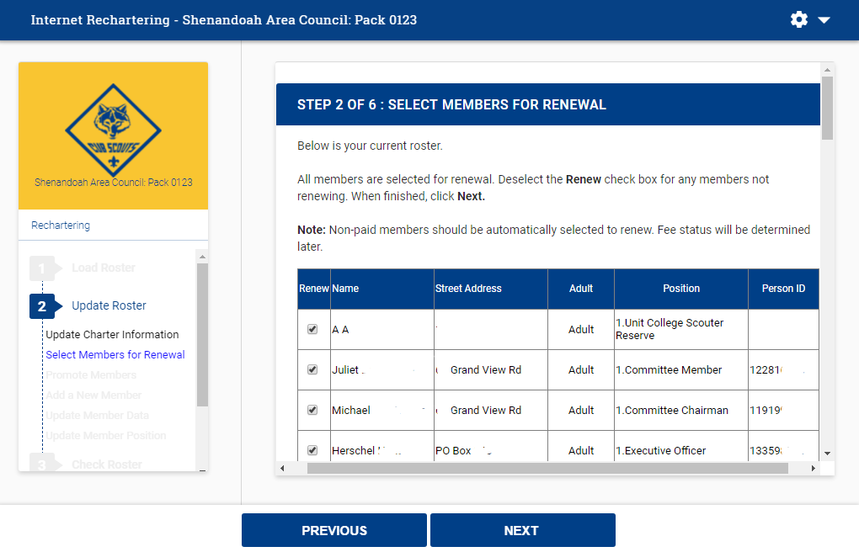
New Branded Look and improved navigation

Slide 42
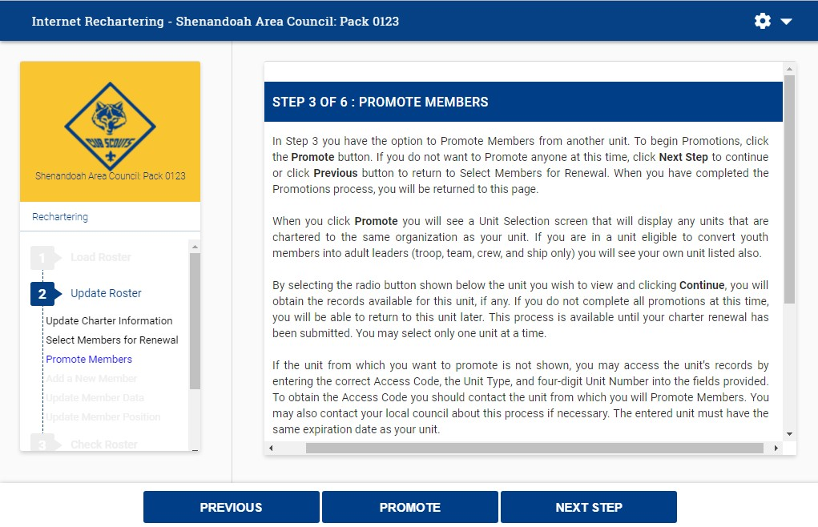
Promote Members within Chartered Family – or with unit access code
HOAC STRONGLY Suggests that you DO NOT USE the “PROMOTE MEMBERS” Function
This run a risk of a youth NOT being registered

Slide 43
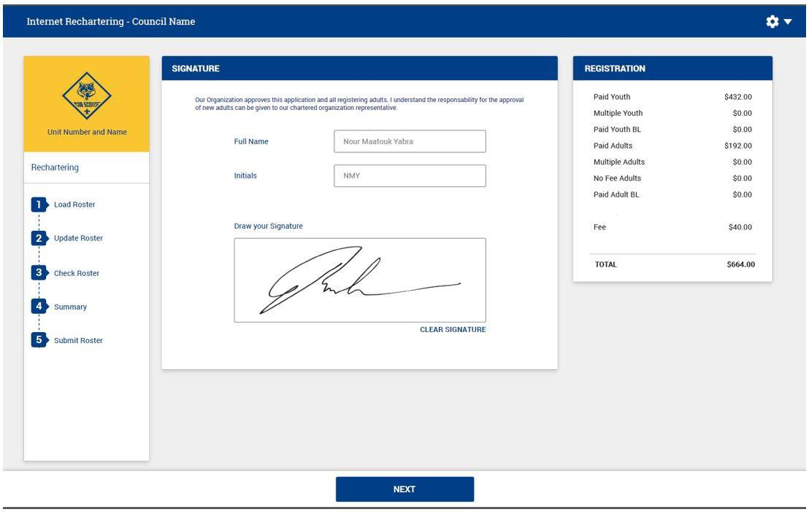
Electronic Approval
THIS MUST BE THE CHARTERED ORGANZATION REPRESENTATIVE (COR)
COR MUST be in ALL 3 blocks

Slide 44
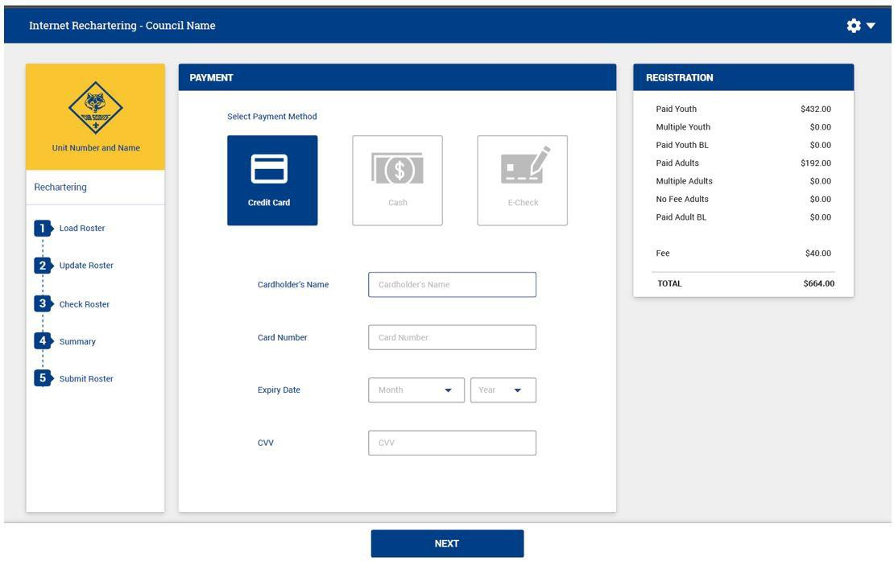
Electronic Payment

Slide 45
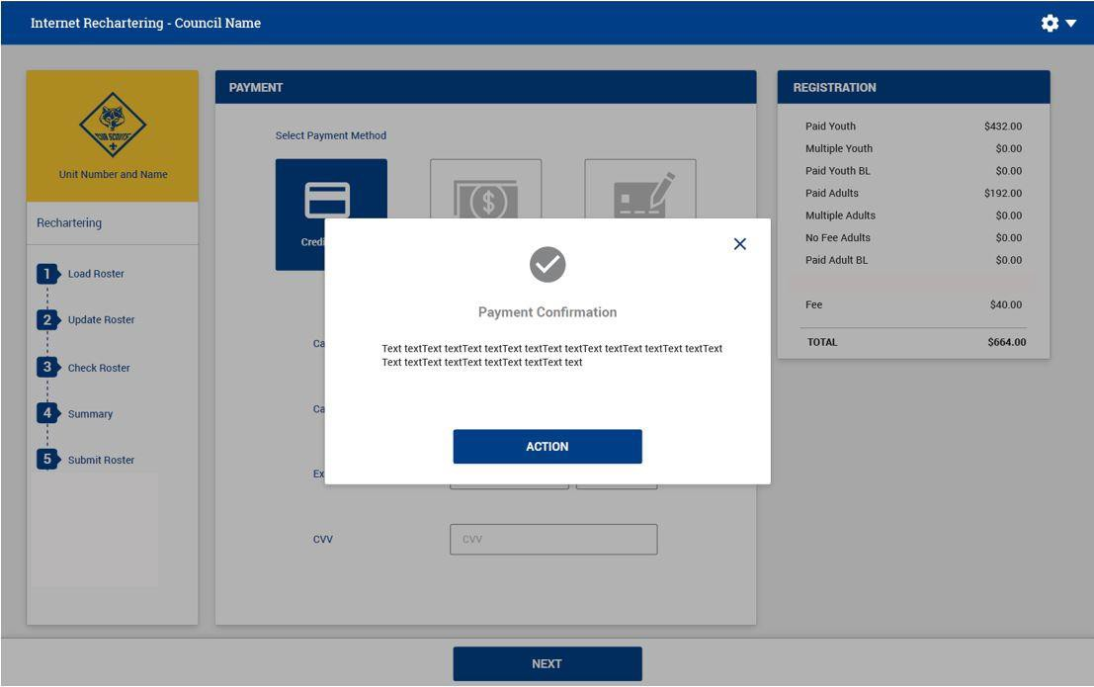
Payment Confirmation

Slide 46


QUESTIONS ??

Slide 47

Re-charter Training
THANK YOU!
Boy Scouts of America
Heart of America Council

