Slide 1
Internet Rechartering
Orientation

Slide 2
Internet Rechartering
Pre-Planning Steps
Step 1: Complete membership inventory of all youth and adults, 60 days prior to your District recharter turn-in meeting, to ensure all members are registered.
Step 2: Ensure ALL Adults have completed Youth Protection Training within the past 2 years. Anyone who has not will not be re-registered. All new applications submitted must also have the Youth Protection Training Completion Certificate attached.
Step 3: Ensure ALL Leaders are fully trained. Anyone who is not, will not be re-registered.

Slide 3
Internet Rechartering
Pre-Planning Steps
Step 4: Obtain correct contact information for all youth and adults, including email address for adult members.
Step 5: Obtain any District specific information that is required for your unit to submit along with recharter at your turn-in day. This could include: FOS Dates, Training Records, Unit Positions; for questions about this check with your District Executive or District Webpage.
Step 6: Contact your Unit Leader and Executive Officer 30 days prior to recharter turn-in day to schedule a time to meet them to get their signatures on the completed recharter paperwork.

Slide 4
The Process
Unit receives access code on sheet inside Recharter Packet
Unit receives location of Recharter Turn in Day-Don’t Miss this Date!
Go to the council Web site and select Internet Rechartering
Complete the rechartering process
Print recharter paperwork
Obtain signature of Unit Leader & Executive Officer
Forward charter paperwork, member applications, correct fees (one check) or unit account authorization, and any other District specific items to your District Recharter Turn-in Meeting

Slide 5
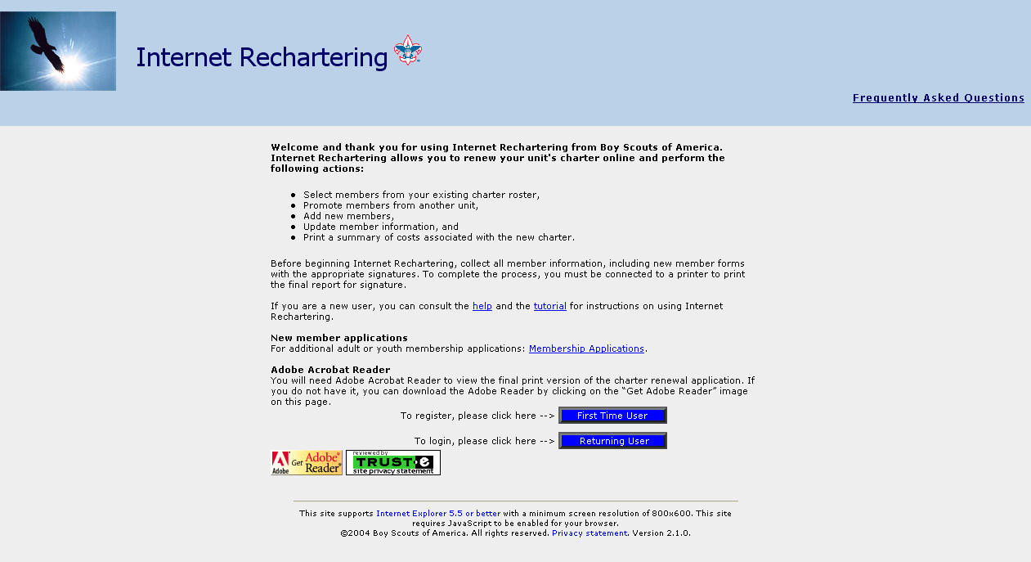
Internet Rechartering

Slide 6
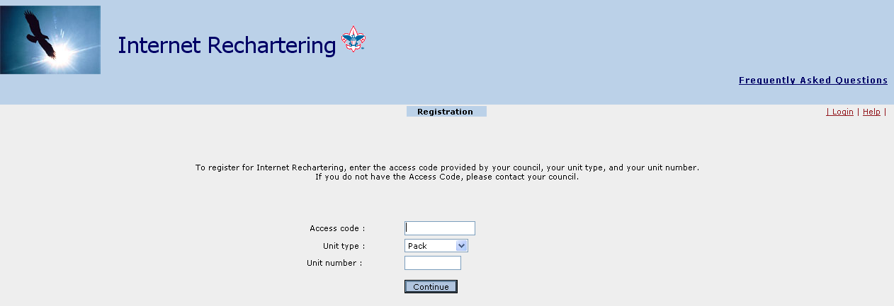
The unit renewal processor for Internet Rechartering begins as First Time User because the unit access code is changed each year for security reasons. After initial registration, log in as a Returning User.

Slide 7
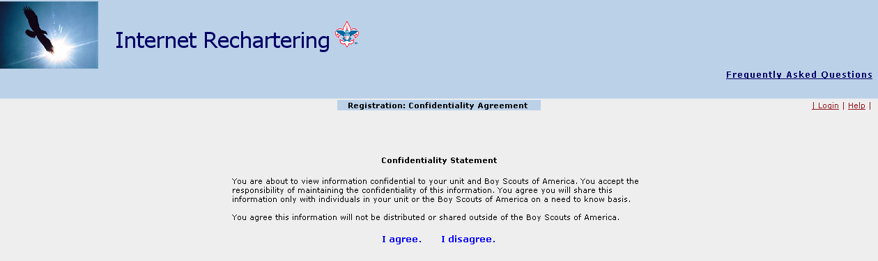
All unit processors are required to agree to a Confidentiality Statement when the initial First Time User registration is completed.

Slide 8
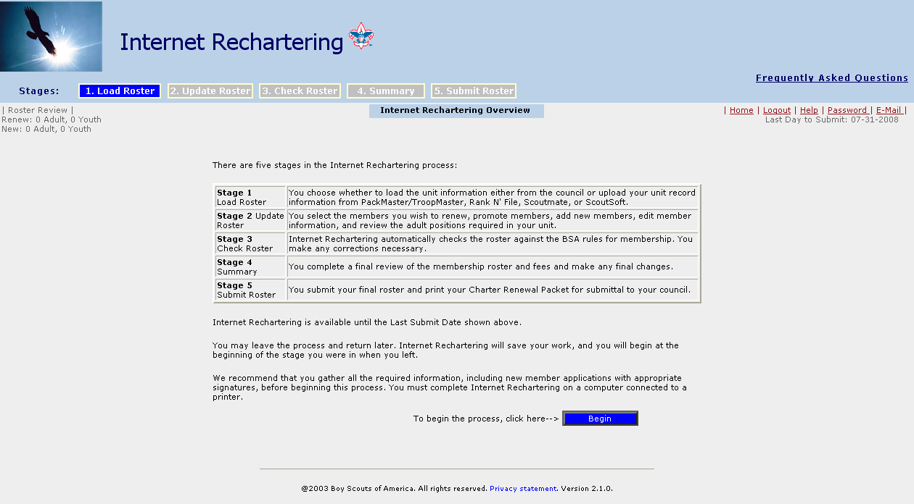
The Overview page lists the five stages of processing for Internet Rechartering. Click Begin

Slide 9
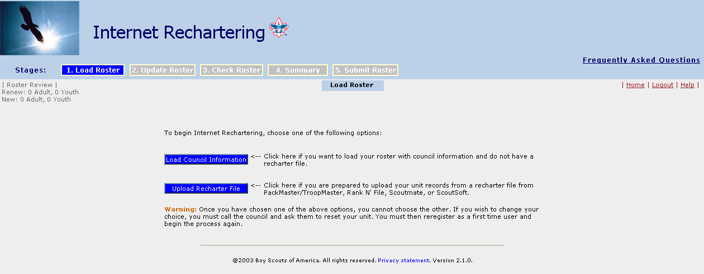
Load Roster offers two options to unit processors: Load the unit roster from council information; or upload a rechartering file from unit-management software to match against the council information.

Slide 10
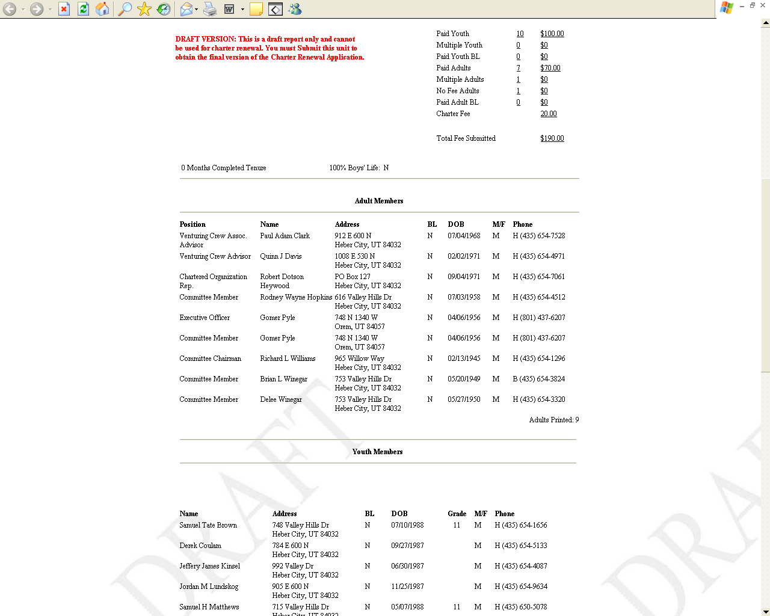
At this point, we suggest that you print out a paper copy of your roster as a “work copy”.
This will be helpful in gathering all of the required information to complete the Charter Renewal process.

Slide 11
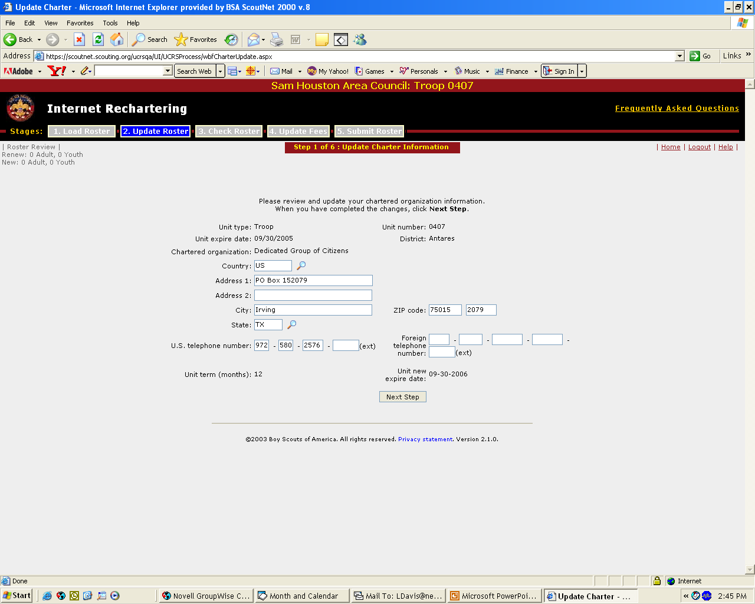

DO NOT MAKE ANY CHANGES TO YOUR CHARTERED ORGANIZATION ON THIS SCREEN! DOING SO WILL CAUSE THE SYSTEM TO FREEZE. PLEASE CROSS OUT AND UPDATE ANY INFO ON THE PRINTED CHARTER.

Slide 12
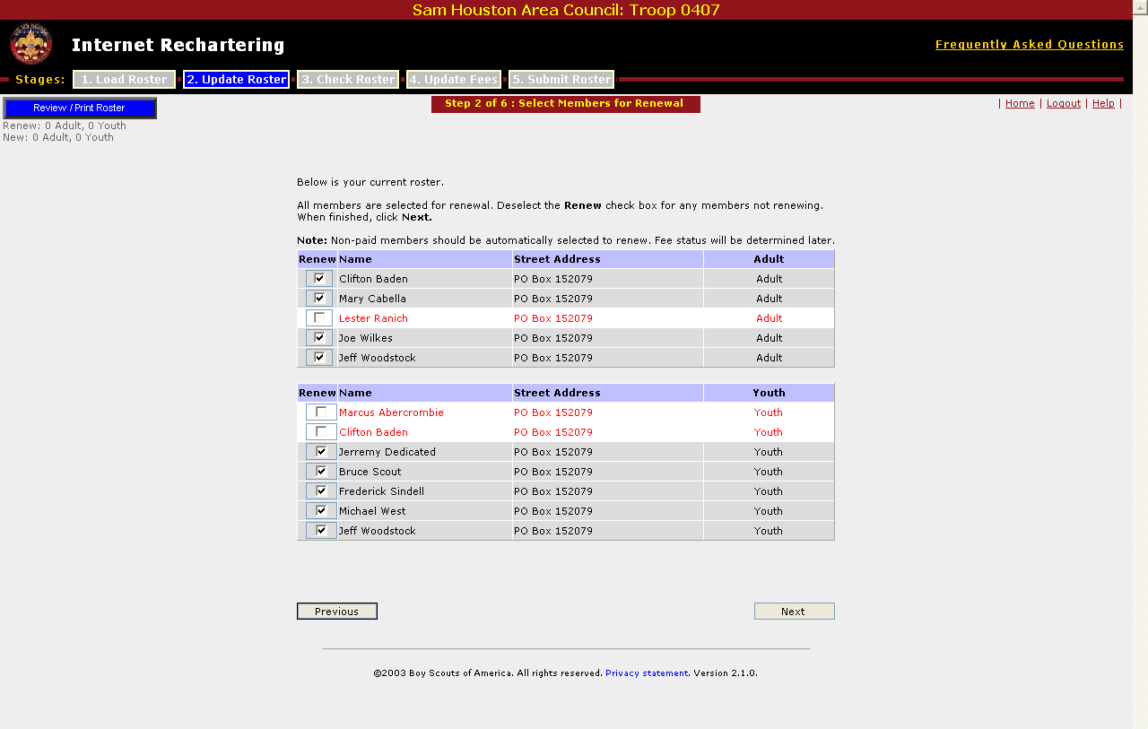
On this screen, you decide who is continuing as a member on your new charter and who is not. Those continuing should have a check by their name.
Quick note to Cub Scout Packs. Please be sure to leave your Webelos II registered with your pack. If they are dropped and subsequently register with a troop, their Arrow of Light Award will not be properly recorded. You can transfer them to the troop later.

Slide 13
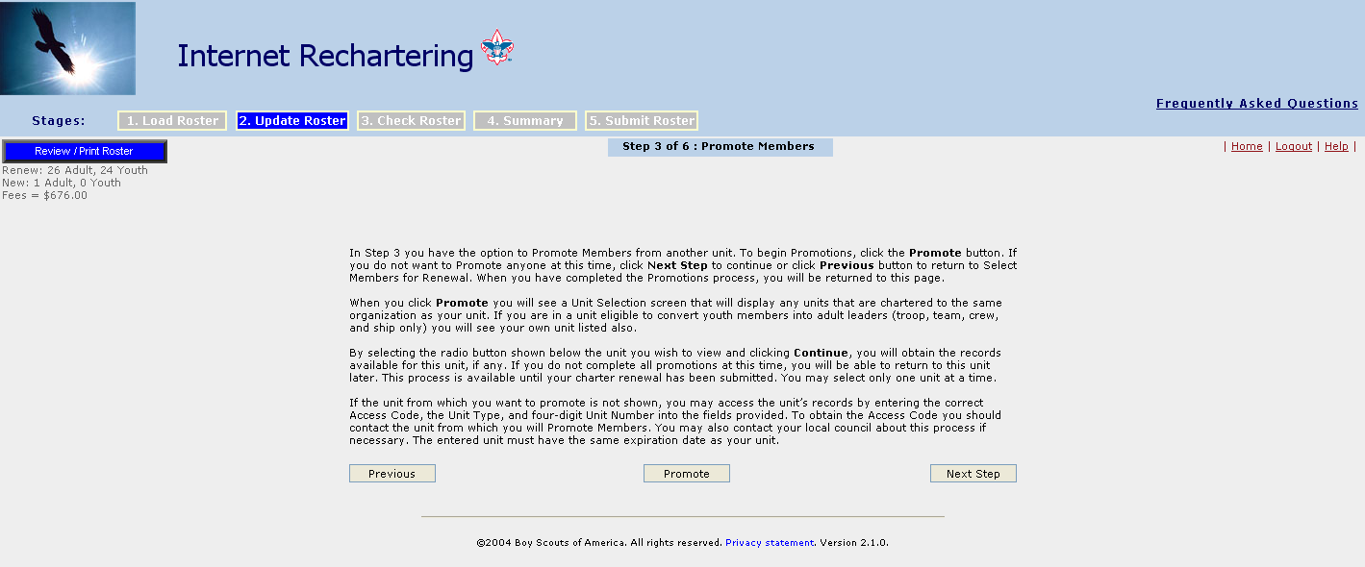
“Promote Members” was a feature that was used to move members from one unit to another (Pack to Troop, Troop to Team, etc). THIS FEATURE IS CURRENTLY NOT WORKING AND SHOULD BE SKIPPED. You can still easily drop members from one unit and add them to another later.

Slide 14
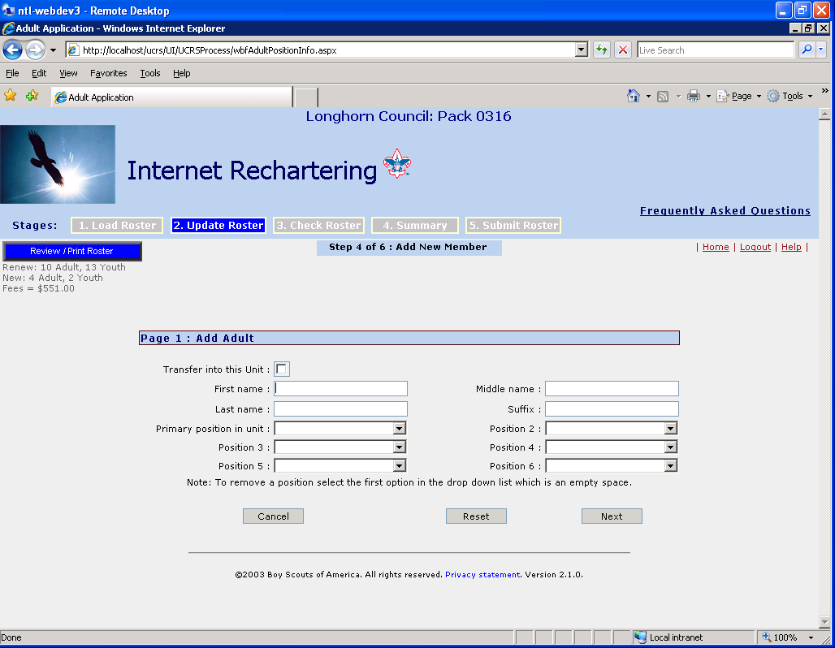
Add New Adult

Slide 15
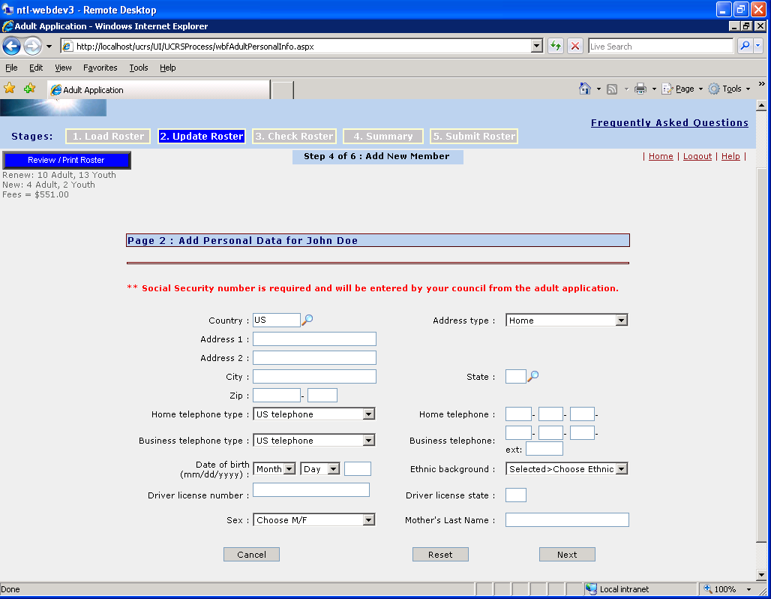
Remember
A paper application must be submitted with your charter renewal for each New or Promoted youth and adult

Slide 16
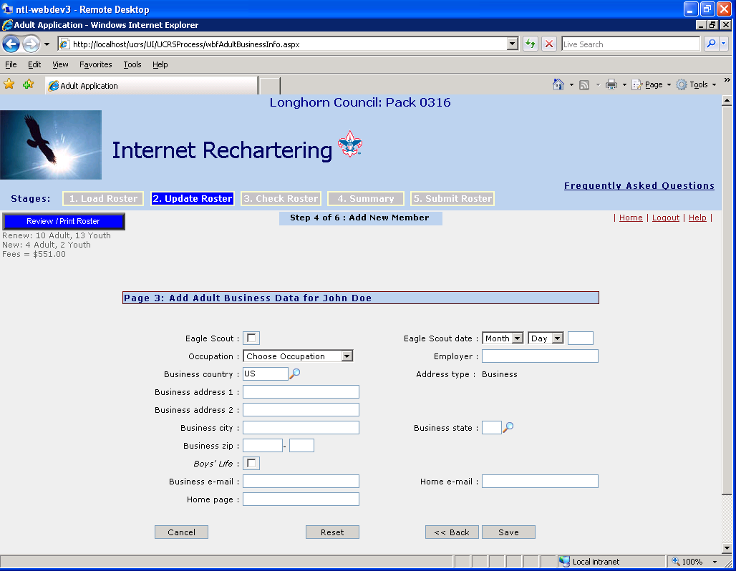
If e-mail address is available, please enter it. This will enable the council to, through Constant Contact, communicate important program information to leaders in a faster and more efficient manner for coming events.
Add Contact Information for Adults

Slide 17
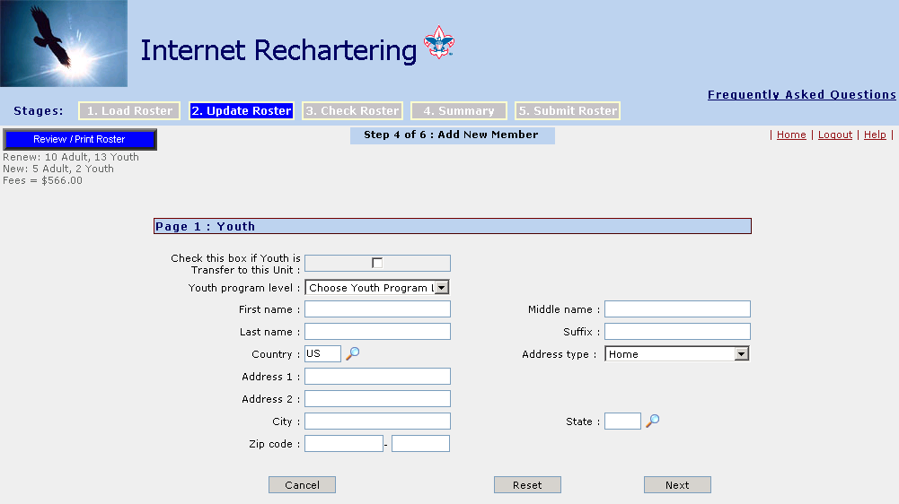
Do not check this box, unless the youth is moving into your unit from another council
Remember
A paper application with signatures must be submitted with your charter papers for each New or Promoted youth and adult.

Slide 18
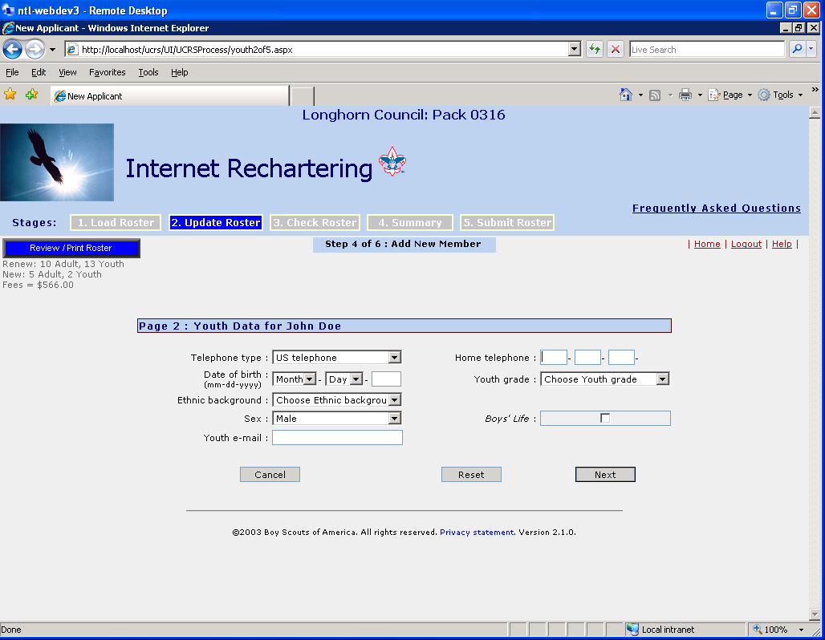
Add Youth

Slide 19
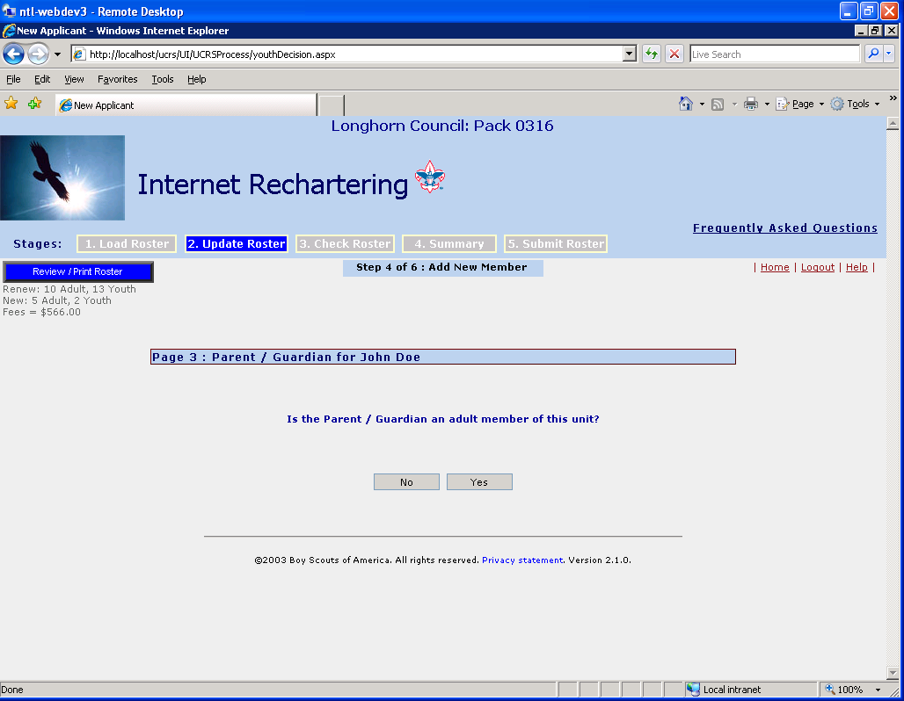
You must select if the parent is or isn’t a current member of the unit. For this reason, it’s a good idea to enter any new adults first.

Slide 20
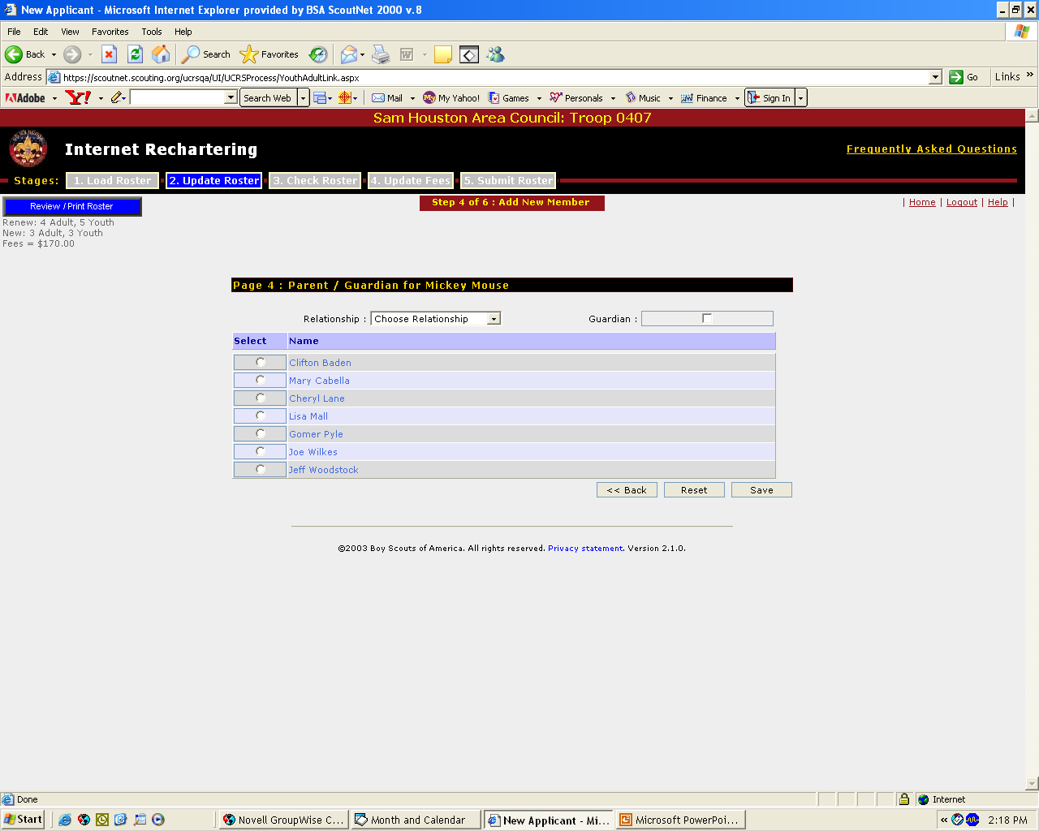
If the parent is registered with this unit, you must select the proper relationship and individual, which automatically inserts the parent’s information on this youth’s application.

Slide 21

Update Information of Parent

Slide 22
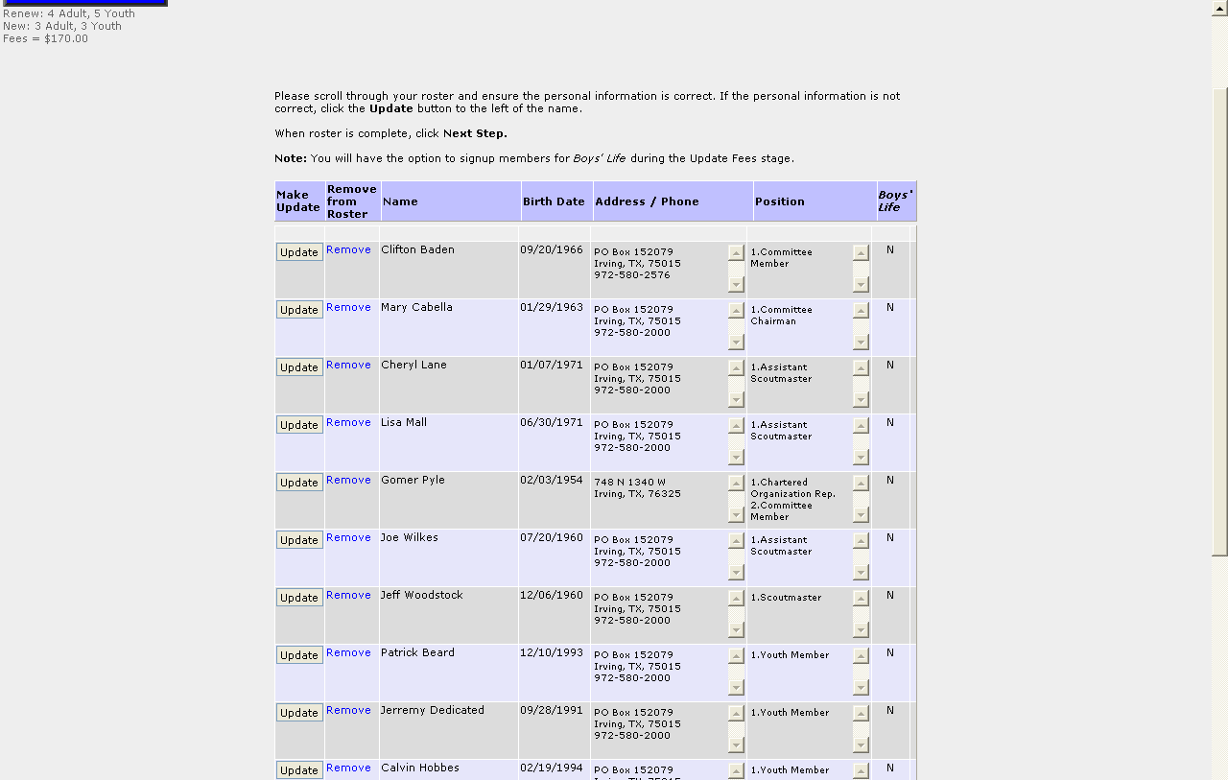
A roster of the selections is presented so you can then update information on any of the adults or youth. If e-mail address is available, please enter it to facilitate faster, more efficient communications. Again, you may remove individuals from the roster.
Update Member Data is a core part of Internet Rechartering as it provides for updating of name, address, telephone, and e-mail address information. If new adults or new youth were entered, records may be updated further in this step.

Slide 23
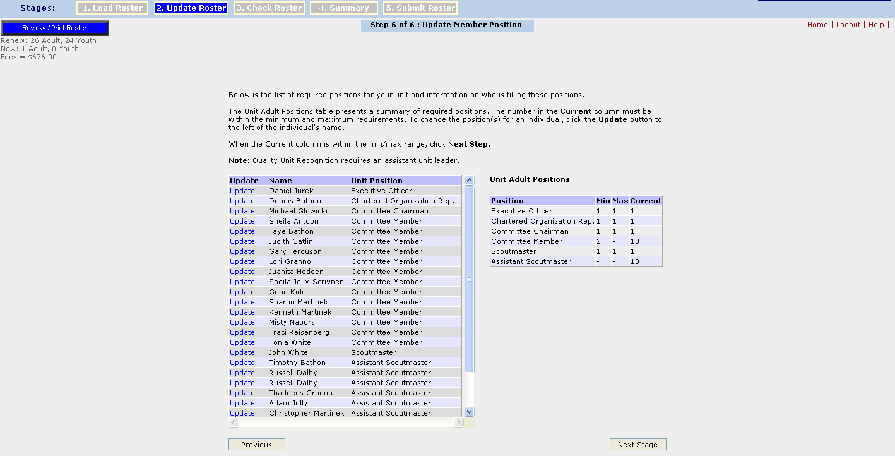
A listing of adults filling required positions is presented with a table of the minimum and maximum requirements and the current status.
If the current number of people for that position does not fall within the minimum and maximum levels, you will not be able to proceed any further, click update to change an adult’s position or go back and add leaders as needed.

Slide 24
Just a reminder
If your Unit is chartered by an organization that also charters another unit you MUST have the same Executive Officer and Charter Representative otherwise Council cannot process your charter paperwork.

Slide 25
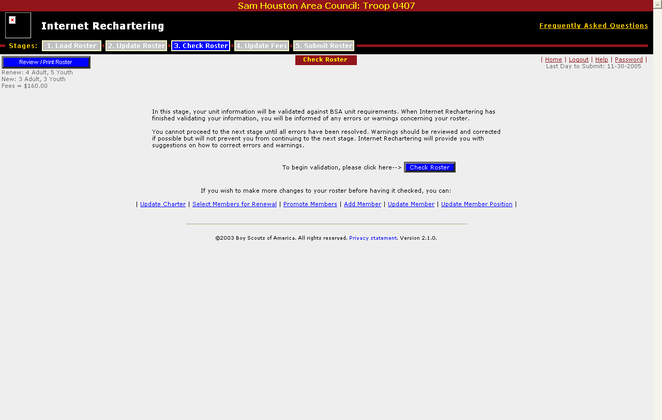
Check Roster verifies BSA registration rules and
Update Fees handles fee payment data.

Slide 26
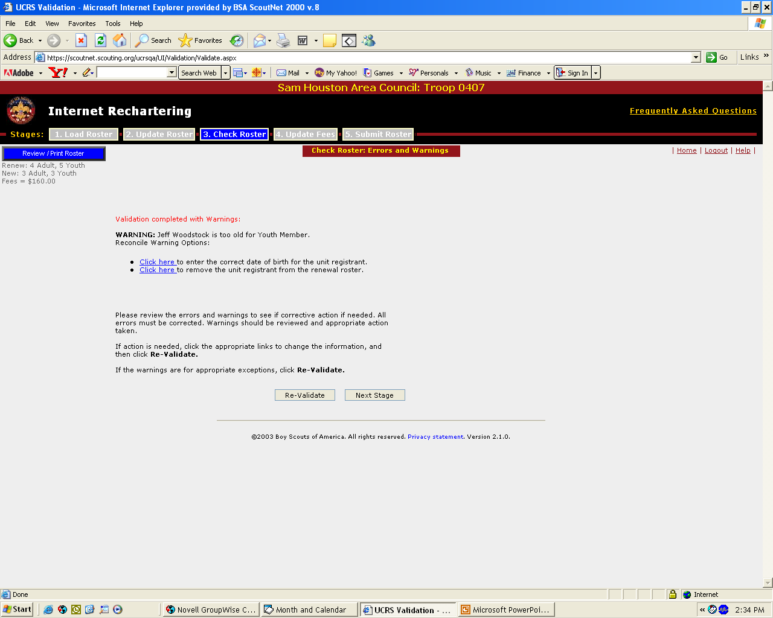
Each individual is checked to ensure that he or she meets the requirements for registration. Warnings and errors may appear.
Errors must be corrected, while warnings should be checked.

Slide 27
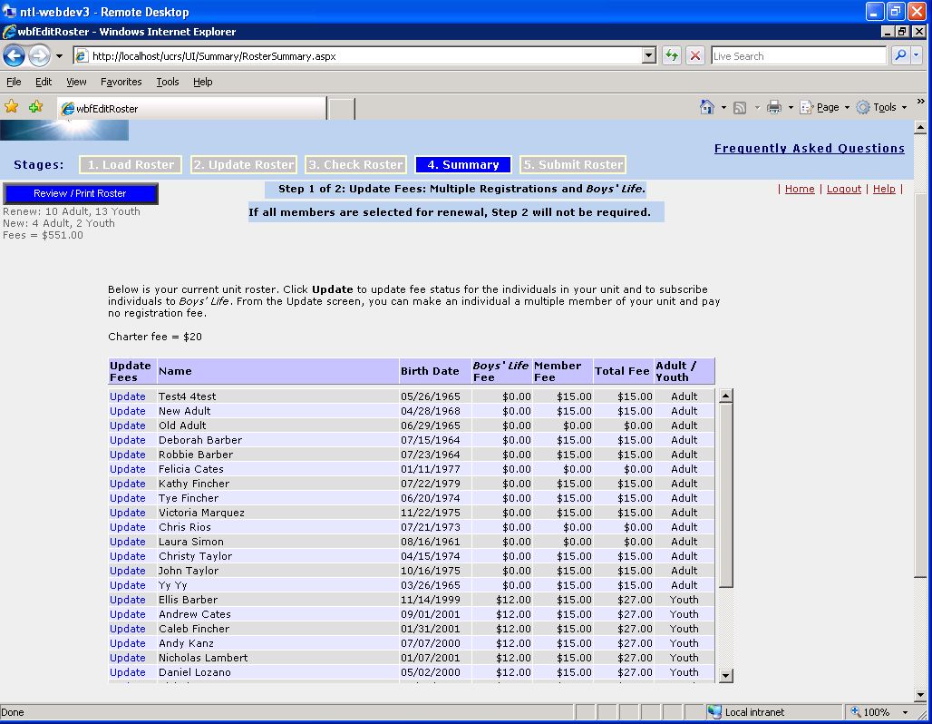
PLEASE NOTE: The 2014 registration fee for youth/adults is $24 and Boys’ Life is $12. Charter fee is $40.

Slide 28
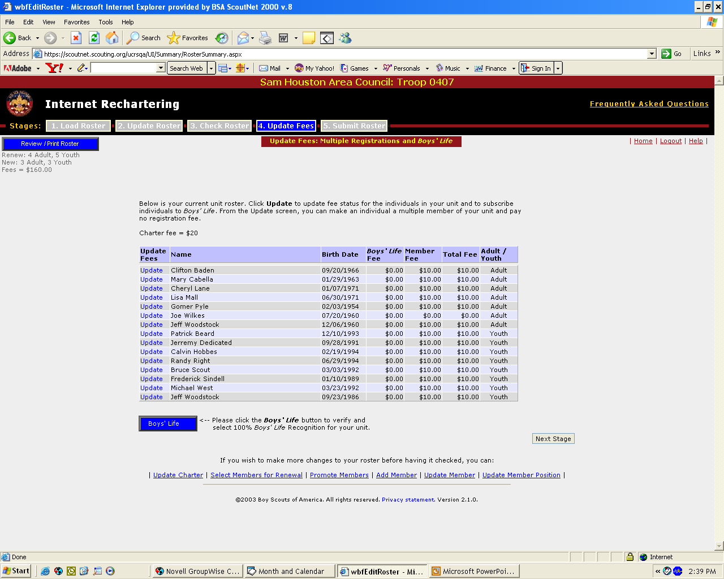
To Add a Boys’ Life subscription or adjust fees for someone already paying in another position or unit, click “Update”
PLEASE NOTE: The 2014 registration fee for youth/adults is $24 and Boys’ Life is $12. Charter fee is $40.

Slide 29
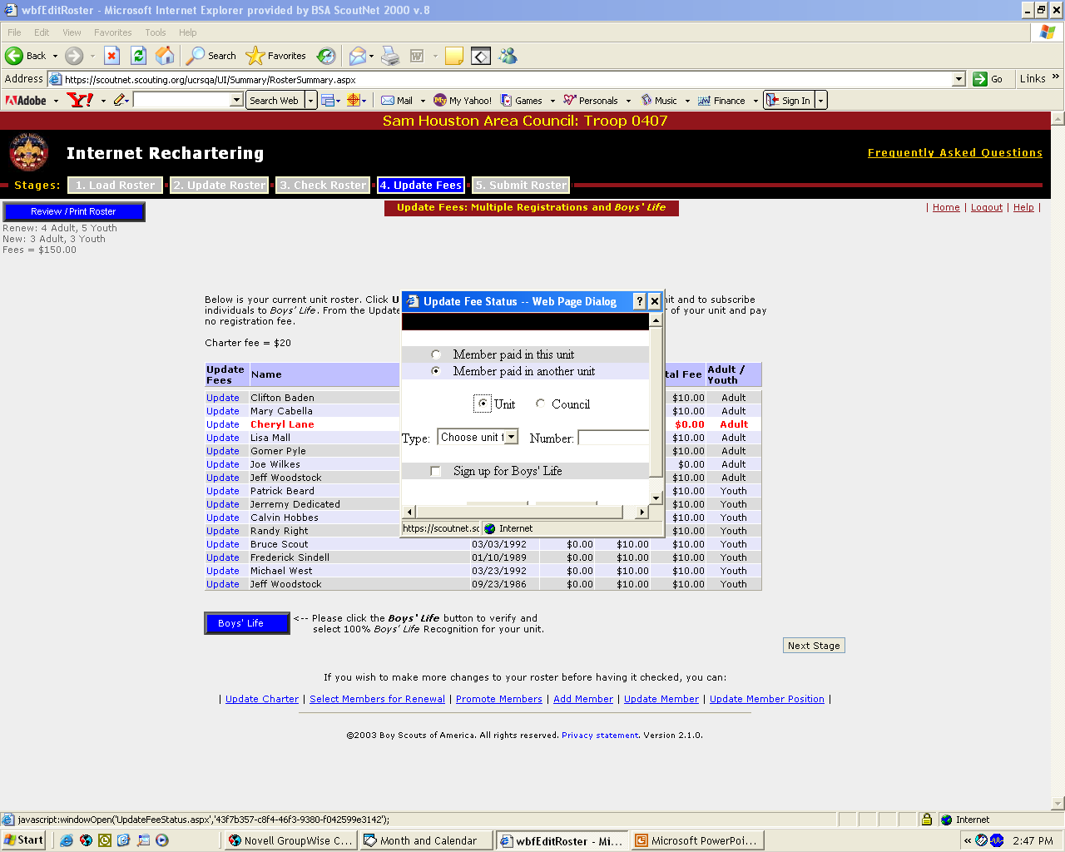
If an adult is paying fees in another unit, You will be prompted to enter where the registration is being paid.
Remember to sign up for Boys’ Life !
Click the Boys’ Life button for your 100% recognition.
PLEASE NOTE: The 2014 registration fee for youth/adults is $24 and Boys’ Life is $12. Charter fee is $40.

Slide 30

Changes made in the “Update Fees” process will be displayed. In this case, Cheryl Lane has paid in another unit/position and her multiple registration status is noted by the fee adjustment.
PLEASE NOTE: The 2014 registration fee for youth/adults is $24 and Boys’ Life is $12. Charter fee is $40.

Slide 31
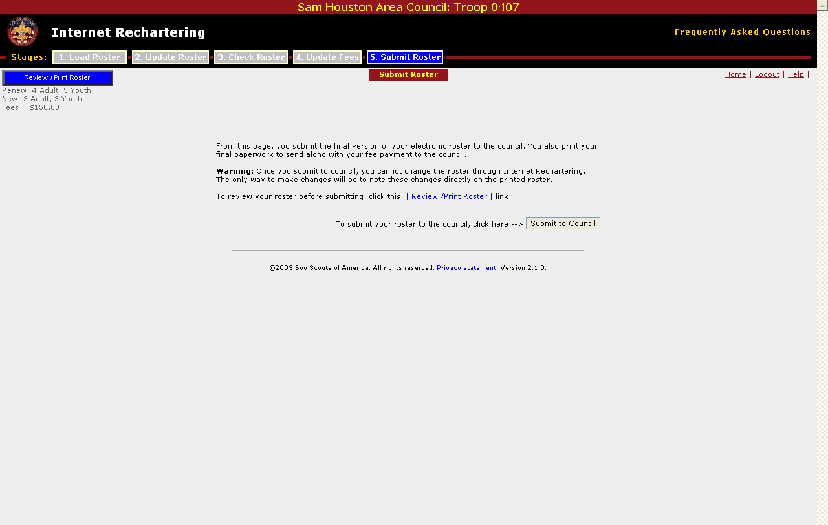
After you press the “Submit” button, you will print the final copy of your charter renewal which will need to be signed by your Unit Leader and Executive Officer before they are turned into the Council. Changes after this point must be noted and explained on the application and then made by the Council.
Submit your roster online

Slide 32
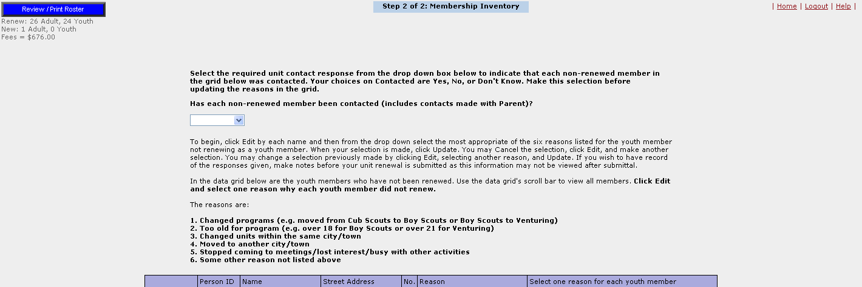
Membership Inventory provides a means to give a reason to each youth member who was not selected for renewal, ranging from too old for program to moved away. This information is shared with councils for follow-up with youth to encourage a continued Scouting experience.

Slide 33
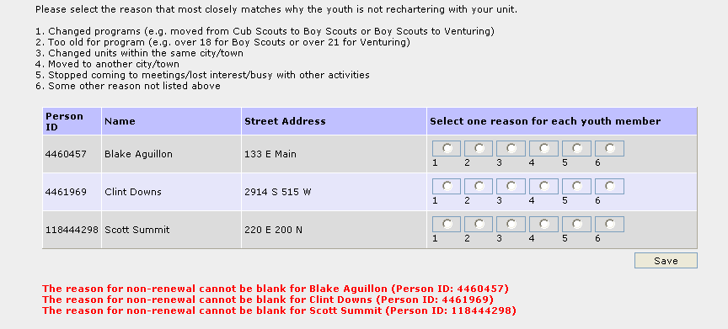
Membership Inventory has been enhanced to allow entry of the
Reason for non-renewal by selecting the appropriate radio button.
Please give an honest assessment as to why Boys dropped from your unit.

Slide 34
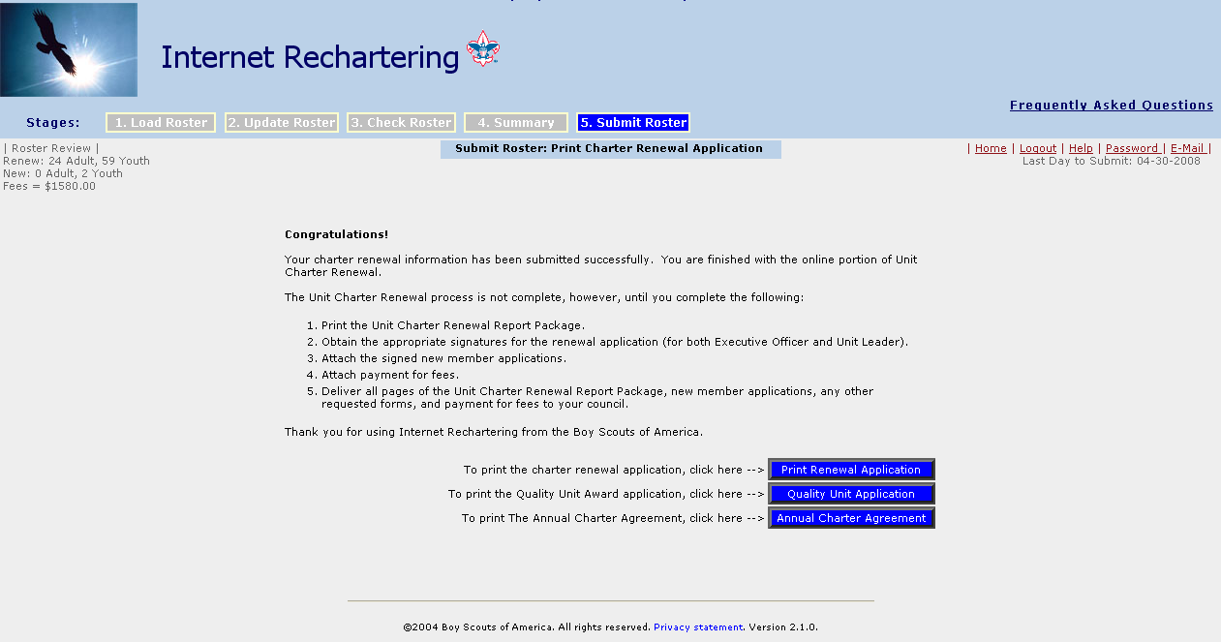
After the unit renewal is submitted, the unit prints the Unit Charter Renewal Report.

Slide 35
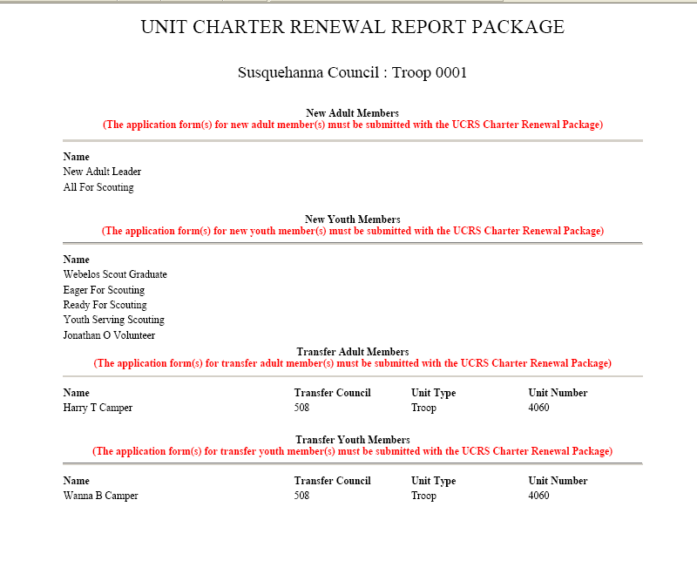
Note: All pages of the final report must be completed and turned in at your District Recharter Turn-in Day
ANYONE (youth or adult) new to your unit is listed on the front page of your charter and needs a signed application to accompany the charter!

Slide 36
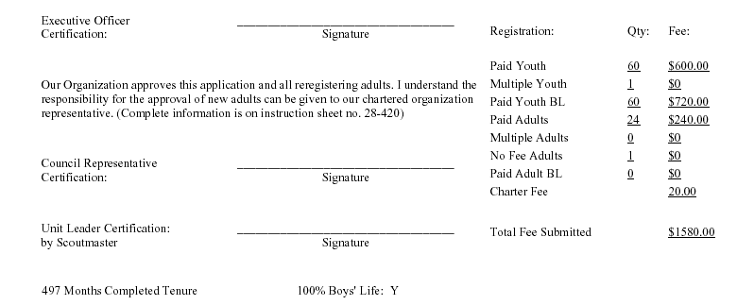
The Unit Charter Renewal Report contains the final total due as well as signature lines. Original signatures for the Executive Officer and Unit Leader must be on the charter when you submit it to the Council! (Council Representative line is for District Executive signature).

Slide 37
What Happens Next?
Submit completed charter, fees and Journey to Excellence Form at January Roundtable (January 9, 2014).
60-90 days after the paperwork is processed at the council office
  Membership Cards & Roster are mailed to Unit Leader
  Charter Certificate is mailed to Executive Officer
  Your Unit Commissioner works with the Executive Officer and your Unit Committee to hold a Charter Presentation

Slide 38
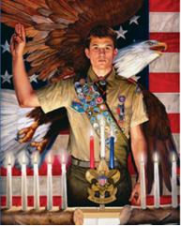
Questions??
Have a Nice Day ☺
Thanks for all you do for Scouting!

